Slide 1

FURNITURE SALES FORECAST
Presented By :
Kushal Singh Ramgadiya

Slide 2
INTRODUCTION
To estimate future trends in sales, profits, gains, etc.
To do this analysis, the owner first has to segregate the data by category and analyze each entity separately.
For each entity, a forecast can be estimated based on the past sales of that entity.
The idea behind this is to find out the popularity of a certain product and how its sales can impact the business

Slide 3
BUSINESS OBJECTIVE
Build a forecast model to predict the Furniture sales of a certain store

Slide 4
TECHNICAL GOALS
Understand the data very well. Do all transformations/ data engineering / etc. wherever applicable
Perform Exploratory Data Analysis (EDA)
Carry out all the Data mining tasks
Identify the salient features that will determine the best results
Perform the model evaluation to select the appropriate algorithms

Slide 5
PROJECT DATA SOURCE/ DESCRIPTION OF DATA-SET
Data sets are provided by NIIT resource.
Consist of 9994 samples and 21 features.

Slide 6
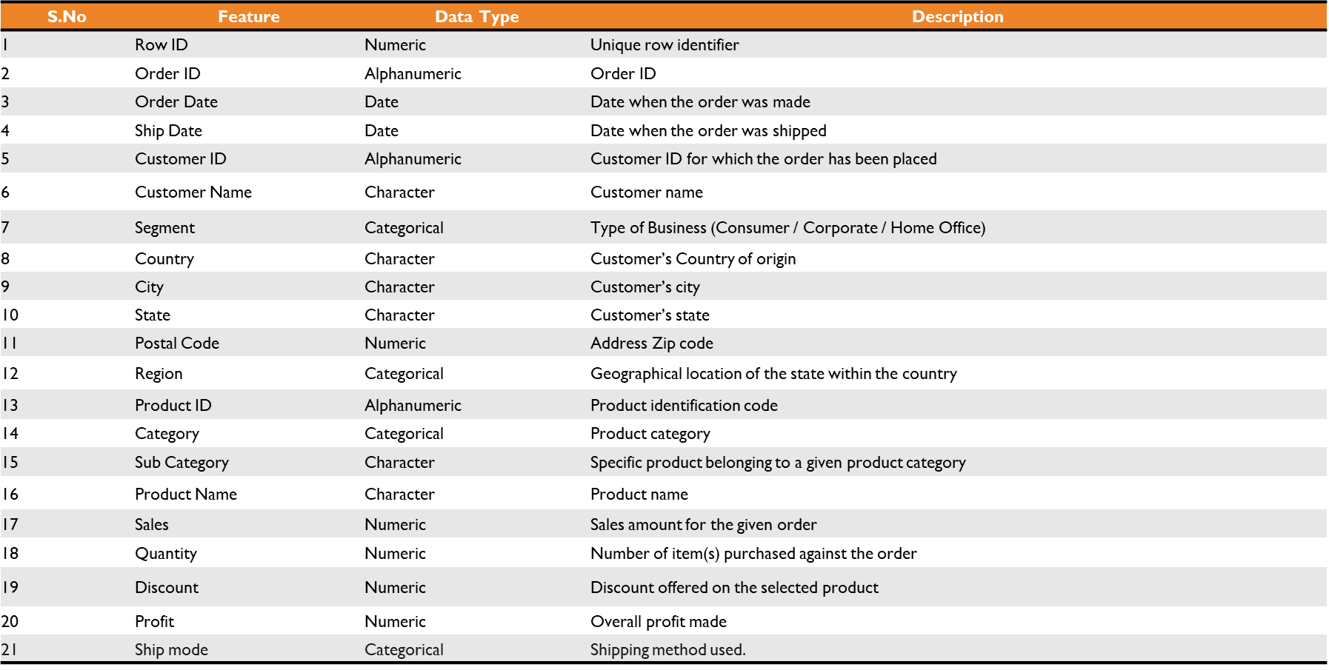

Slide 7
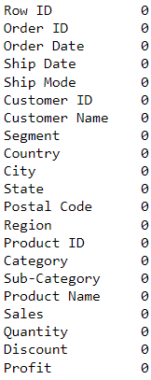
TREATMENT OF DATA SET
No null values
No duplicate values

Slide 8
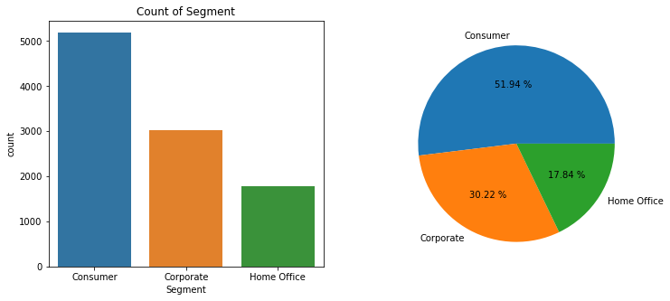
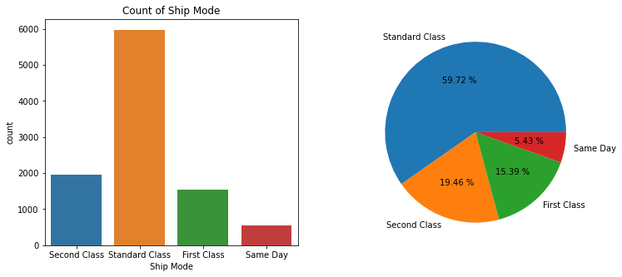
EXPLORATORY DATA ANALYSIS (EDA)
The consumer has the highest rate compared to other segments
The standard class has the highest rate of count

Slide 9
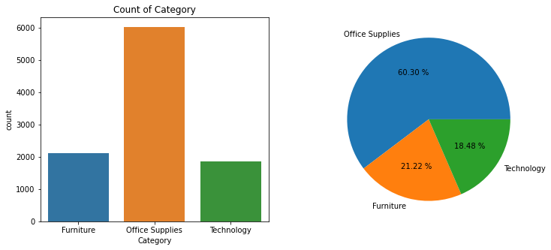
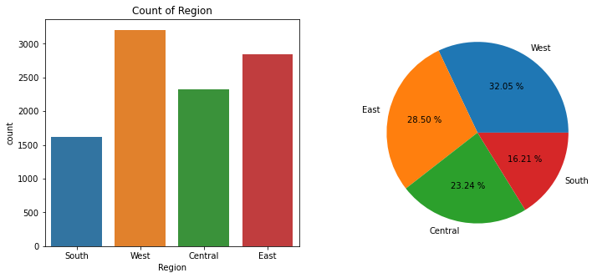
Office Categories Are Performing Far Better As Compare To Furniture And Technology
The West Region is leading in terms of sales followed by the East and Central Region

Slide 10
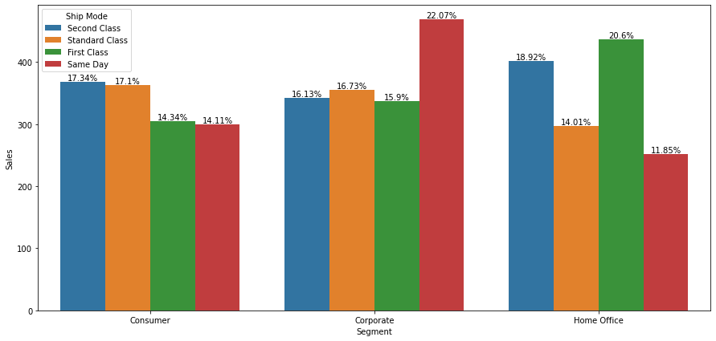
Customers in the Corporate Segment purchase more as compared to Consumers and Home Office.

Slide 11
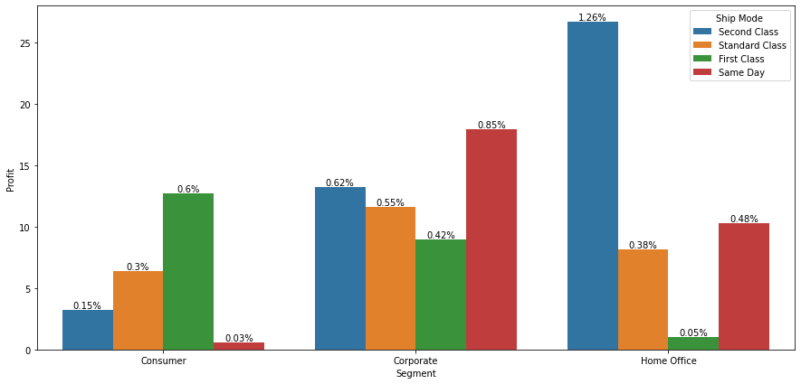
In the HOME OFFICE segment, the Second Class shipping method is more popular and makes a good profit.
In the CONSUMER segment and HOME OFFICE we can close the Same Day services as profit is negligible.

Slide 12
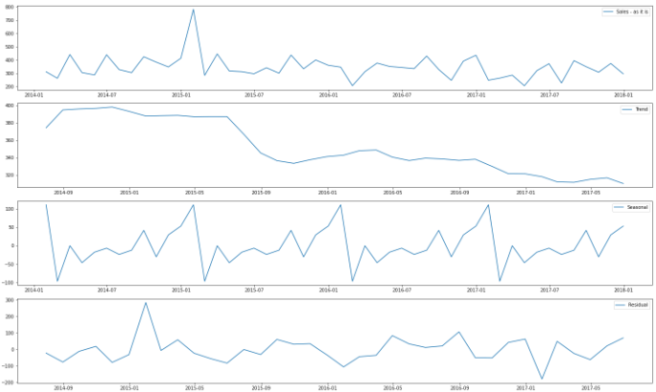
VISUAL INSPECTIONS ABOUT DATA
Sales
Trend
Seasonal
Residuals

Slide 13
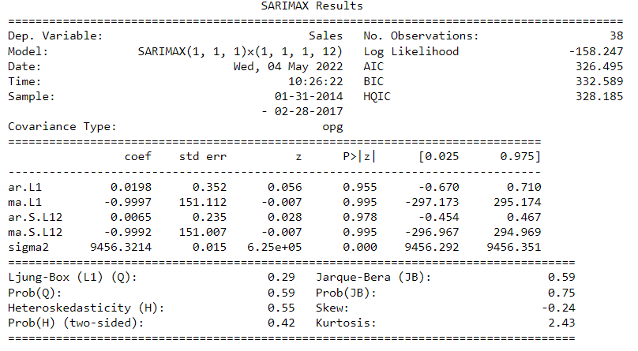
MODEL BUILDING: USING SARIMA
Autoregressive Integrated Moving Average, or ARIMA, is one of the most widely used forecasting methods for univariate time series data forecasting.
Although the method can handle data with a trend, it does not support time series with a seasonal component.
An extension to ARIMA that supports the direct modeling of the seasonal component of the series is called SARIMA.

Slide 14
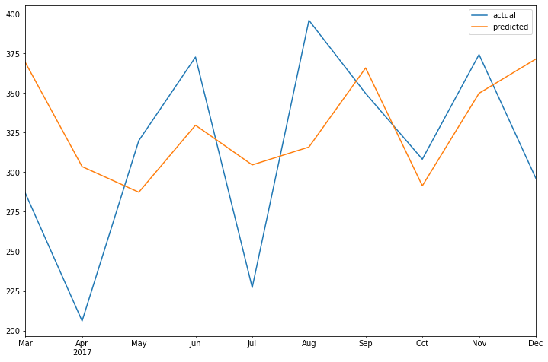
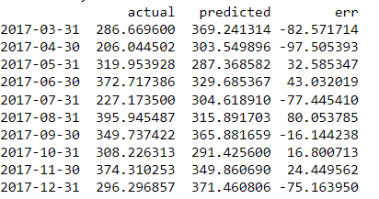
ACTUAL VS PREDICTED VALUES
Actual vs Predicted values table

Slide 15
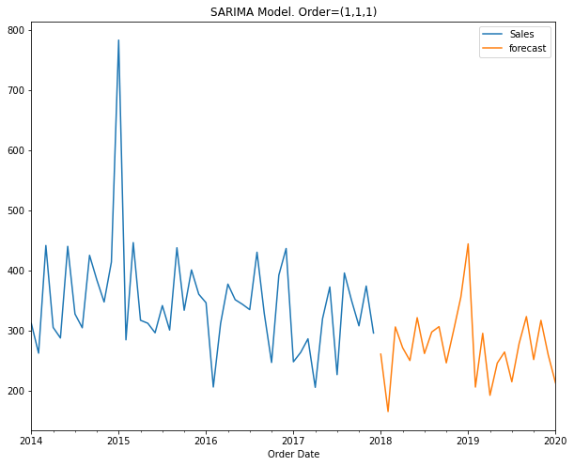
FORECAST THE FUTURE SALES USING THE MODEL

Slide 16
COMPARISON WITH OTHER ALGORITHMS
ARMA - ARMA is a model of forecasting in which the methods of autoregression (AR) analysis and moving average (MA) are both applied to time-series data.
ARIMA - An autoregressive integrated moving average, or ARIMA, is a statistical analysis model that uses time-series data to either better understand the data set or to predict future trends.
 | ARMA | ARIMA | SARIMA
AIC | 460.331 | 451.194 | 326.495
BIC | 466.881 | 456.027 | 332.589
RMSE | 73.65 | 72.70 | 61.99

Slide 17
CONCLUSION
By comparison of ARMA, ARIMA, and SARIMA sales forecasting, indicates that the SARIMA model is the best compared to other models.

